Slide 1
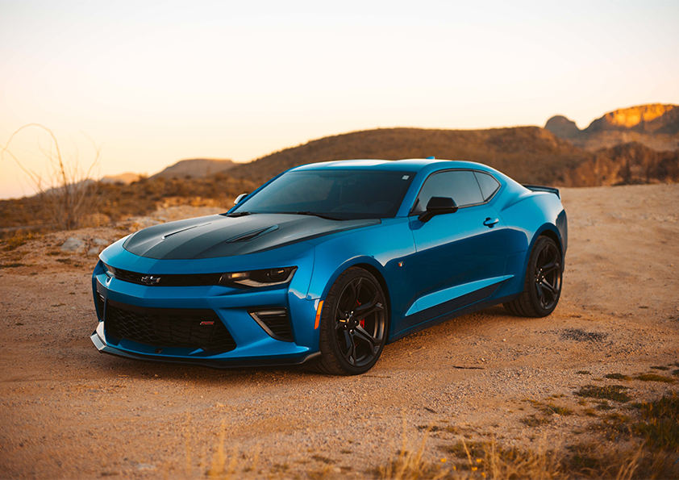
The Evolution of Cars.

Slide 2
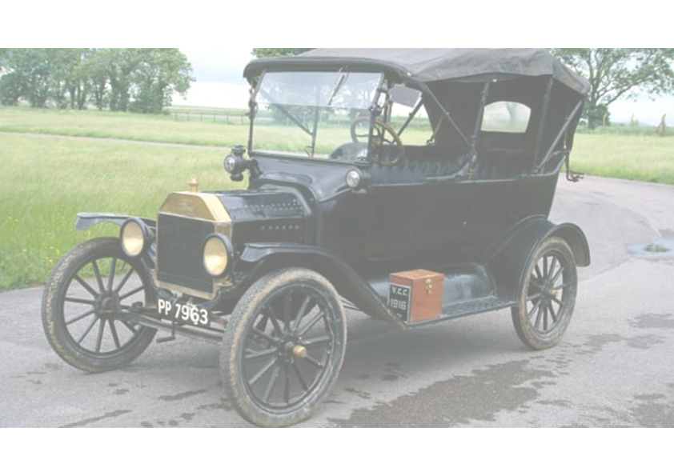
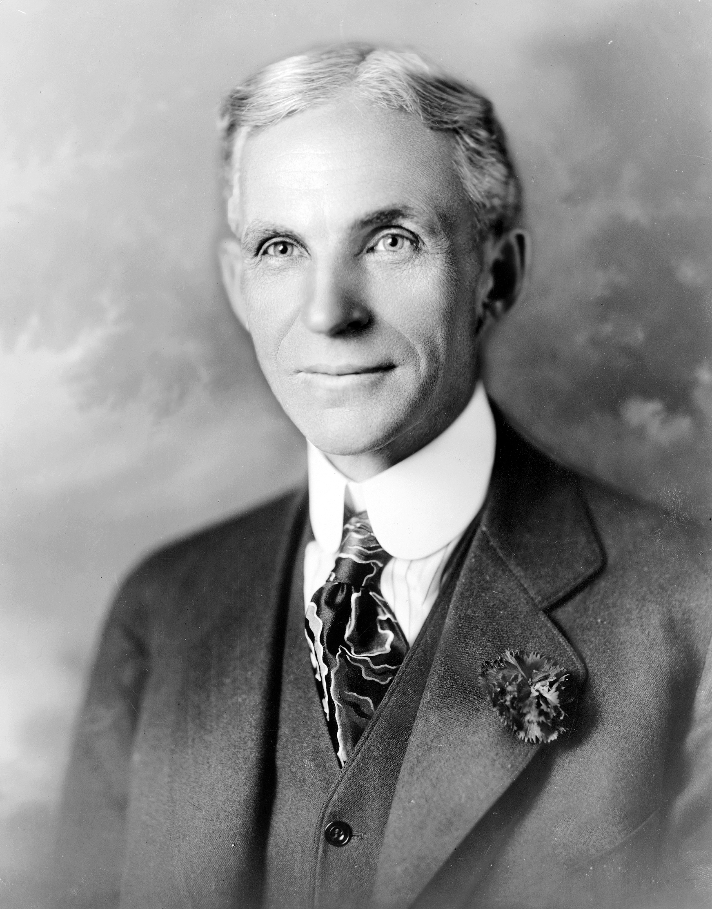
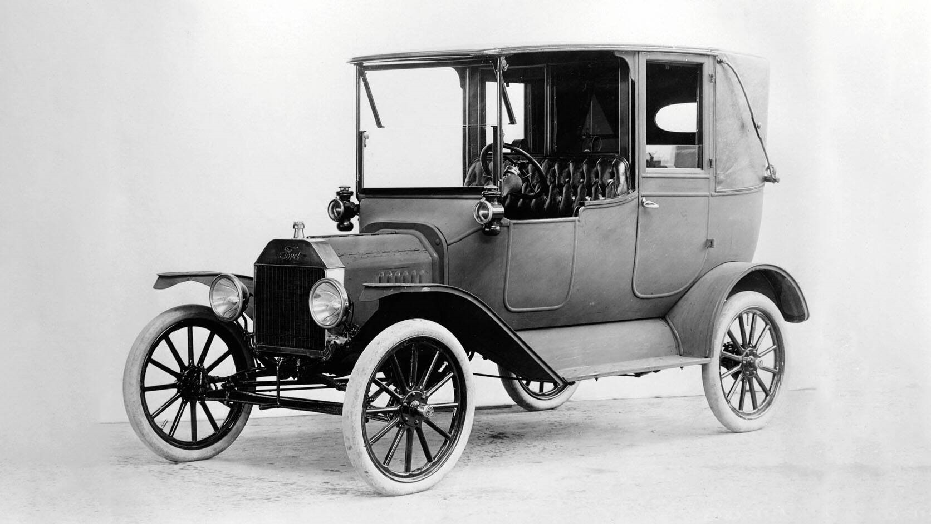
Steam Powered Vehicles:
Those first “vehicles” were powered by steam. It was an energy source that had been used
for many years to power trains. However, it wasn’t until the 1870s that steam power became more
practical for small vehicles. Despite improvements, there were still a lot of shortcomings.
Steam-powered vehicles took a very long time to start up and the range was limited.
Ford Model T : One of the first mass
Produced cars
Henry Ford, The pioneer of
Automobile industry.

Slide 3
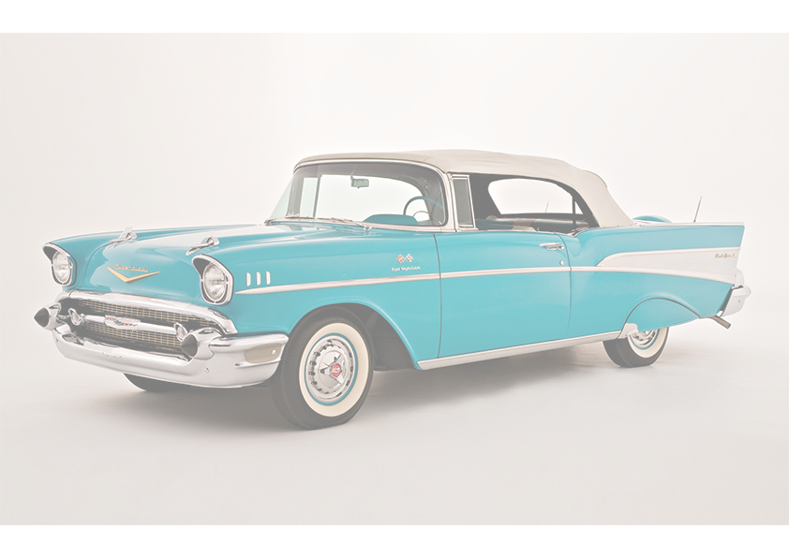

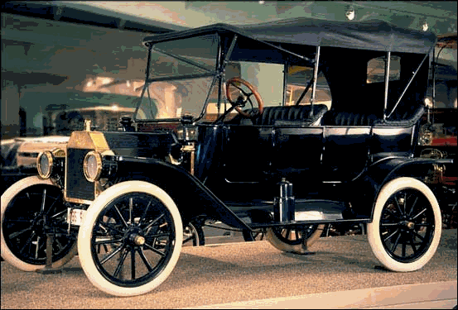
Mass Produced Gas-Powered Cars:
While some of the very first cars were powered by steam engines, dating back to the 1700s,
it was Karl Benz in 1885 who invented the first gas-powered car, which he later received a patent
for in 1886. Benz’s first car had three wheels, looked much like an elongated tricycle and sat two
people. Four-wheeled gas-powered cars were later introduced in 1891.
Men working on assembly line.
A car from the newly established
Steam engine era.

Slide 4
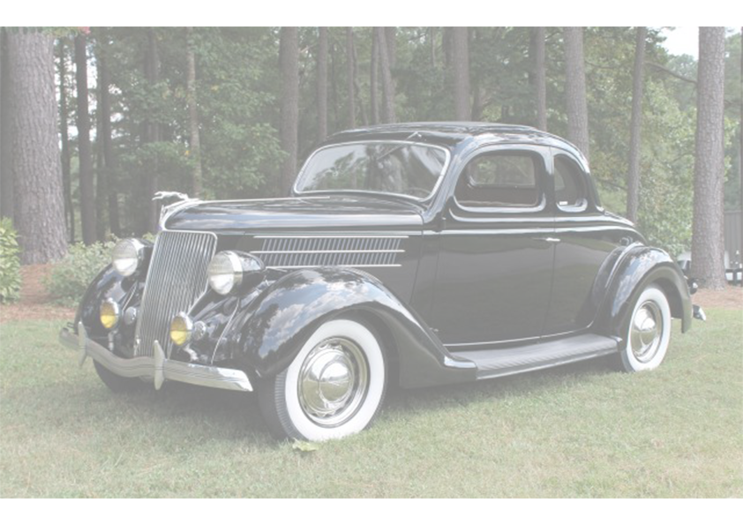
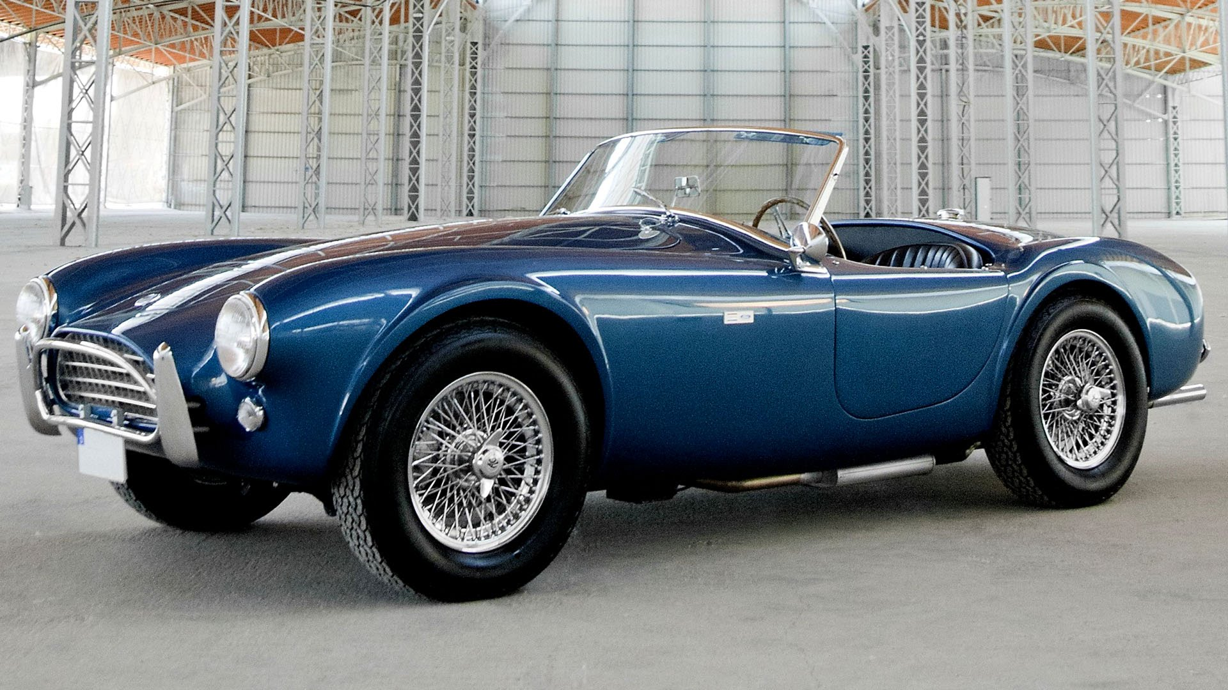
Vehicles Features Take Center Stage (1930s-2000s):
Along with mass production came new features, some of the first being speedometers, seatbelts,
windshields and rearview mirrors. Believe it or not, the first turn signals weren’t added to a car until
Buick did it in 1939 – that’s even after the first car with electric windows and air conditioning!
Then cars started to get fancy, with power steering (1951), cruise control (1957), three-point seatbelts
(1959) and heated seats (1966).
In 1973, Oldsmobile installed the first passenger airbag into their “Tornado” model. Over 20 years later
in 1998, the federal government required all passenger vehicles to come standard with dual
frontal airbags.
A Sports car from
1960s.

Slide 5
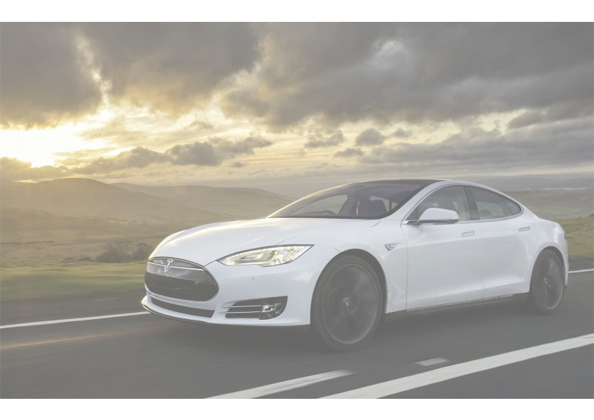

Modern Vehicles:
This brings us to modern-day cars with Bluetooth, hard drives, advanced safety systems, GPS, WiFi and
even the ability to parallel park themselves. It seems crazy, but it’s true. In this age, cars come standard
with features that were once a luxury (or didn’t even exist at all). And driverless cars that once
seemed like something out of a science fiction film are close to being a reality. It’s amazing to think how
far cars have come and where the technology will go down the road.
Mazda Rx7 released in
Early 2000s

Slide 6
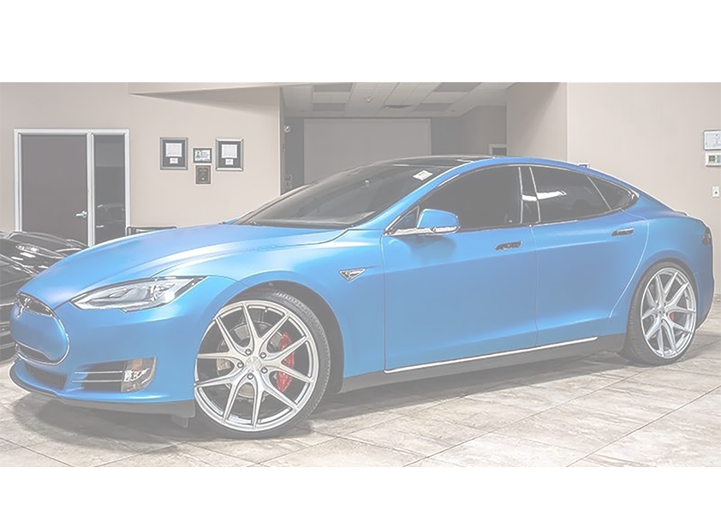
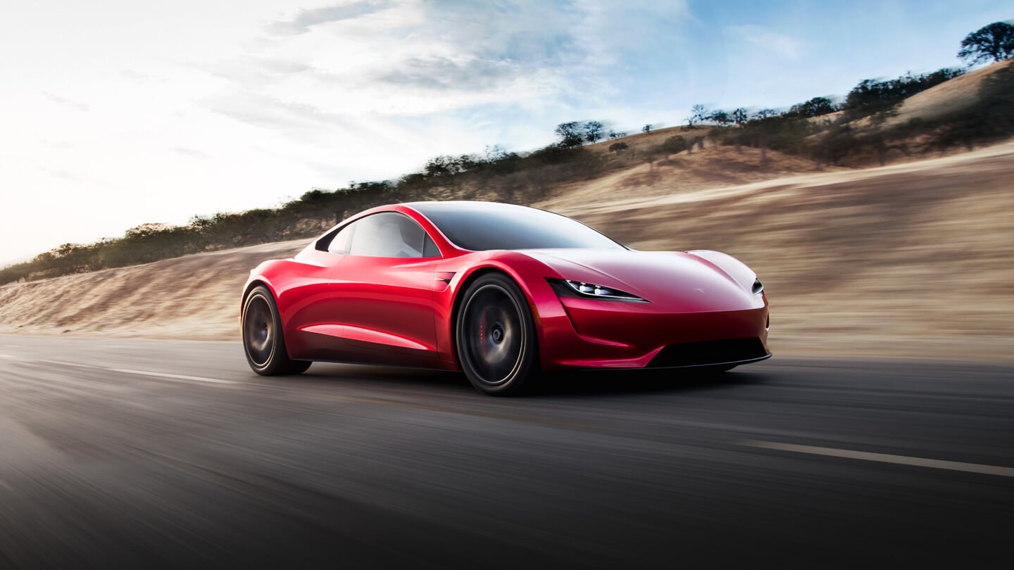
The future of cars is electric but how soon is this future?
Electric cars will soon overtake internal combustion-powered cars as the more economical choice
for consumers, according to the new report. Over the next two decades, worldwide electric
vehicle sales will rise from 2 million last year to 56 million by 2040, BNEF predicts.
A Tesla roadster

